Slide 1
Hadoop Setup
Jay Urbain, PhD

Slide 2
Setting Up Hadoop
Hadoop binaries or vendor distribution
Use vendor distribution, check packages
Hadoop version
Usually latest stable release ~2.7
Location
Local cluster install
Free, but complicated unless standalone mode
Local VM
Must install virtualization software
Cloud
Costs money to test
Need to remember to turn off
Great for episodic compute needs

Slide 3
Data Storage
Local
File system (single)
Note: Developing MapReduce algorithms are complicated. Keep things simple.
HDFS – pseudo or distributed
Cloud
HDFS
S3 AWS/ BLOB Azure

Slide 4
Libraries
MapReduce
Version 1.0 or 2.0 (YARN)
Other libraries
Hive and Pig are common, additional tools vary by vendor

Slide 5
Cloudera
OS + virtualization software
Download Hadoop virtual machine image for that virtualization software
Adding core libraries
Hive – SQL-like query, create batch (MapReduce) queries
Pig – ETL-like language
Impala – like Hive but real-time versus batch
Mahout – machine learning algorithms
Spark – in-memory processing of resilient distributed data set
Storm – complex event processing

Slide 6
MapReduce Programming Language
Programming Languages
Java
Python (streaming)
C++ (pipes)
R
Hadoop IDEs
Eclipse (Java)
Python (Sublime, PyCharm)
R Studio

Slide 7

Cloudera Quickstart

Slide 8
Hands on - Cloudera VM Walkthrough
Which of the following Hadoop libraries gives you the ability to have SQL-like, or HQL query and creates batch MapReduce jobs with that query?
Impala
Mahout
Pig
Hive

Slide 9
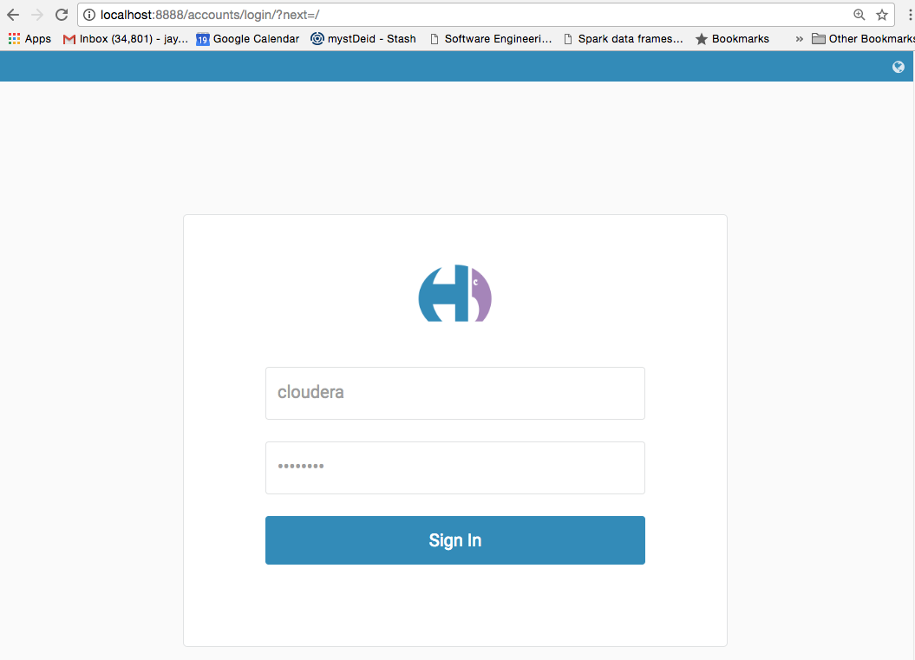

Slide 10
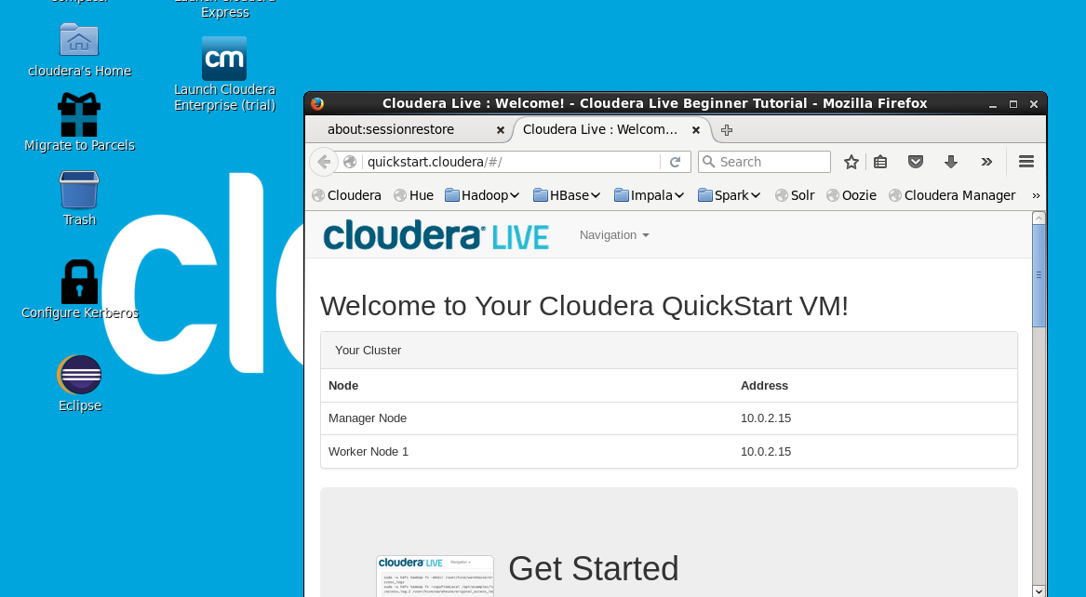
Startup Cloudera VM

Slide 11
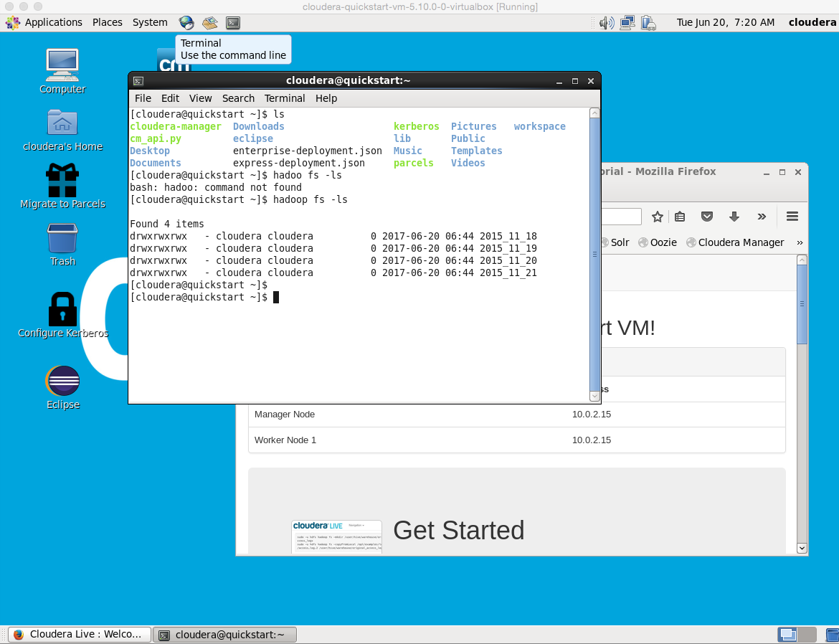
Access the terminal

Slide 12
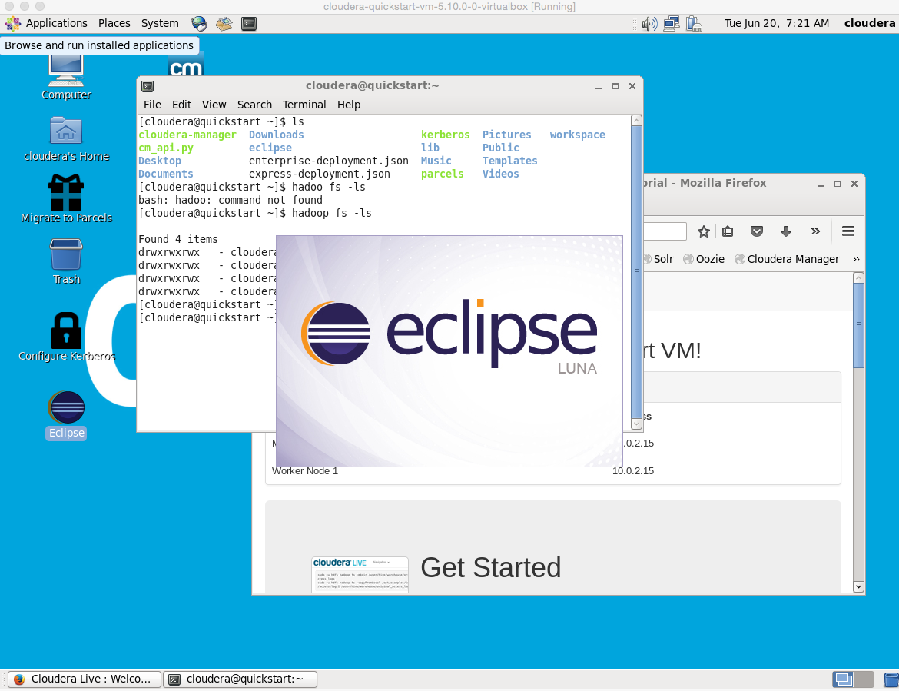
Eclipse

Slide 13
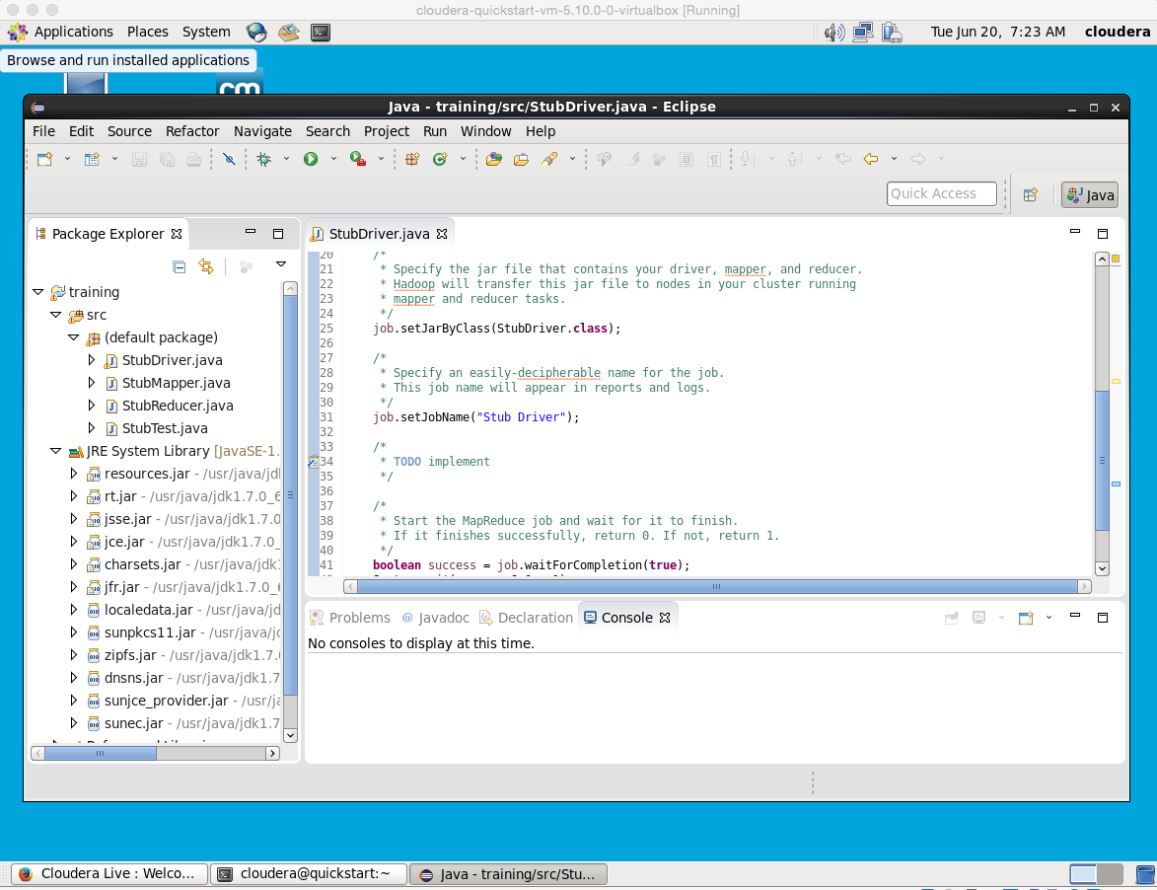
Stub Application and Libraries

Slide 14
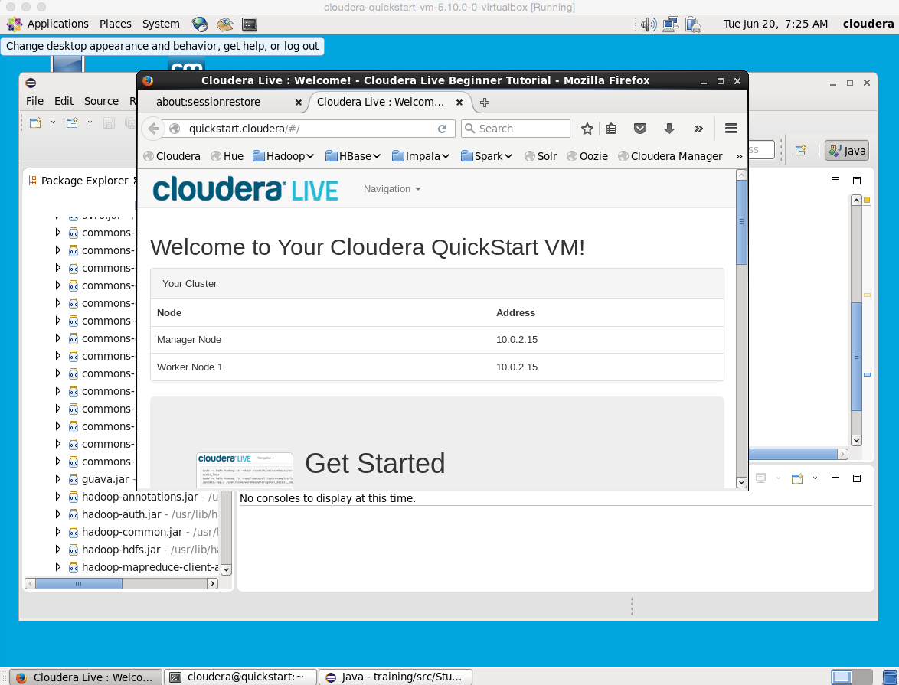
Firefox

Slide 15
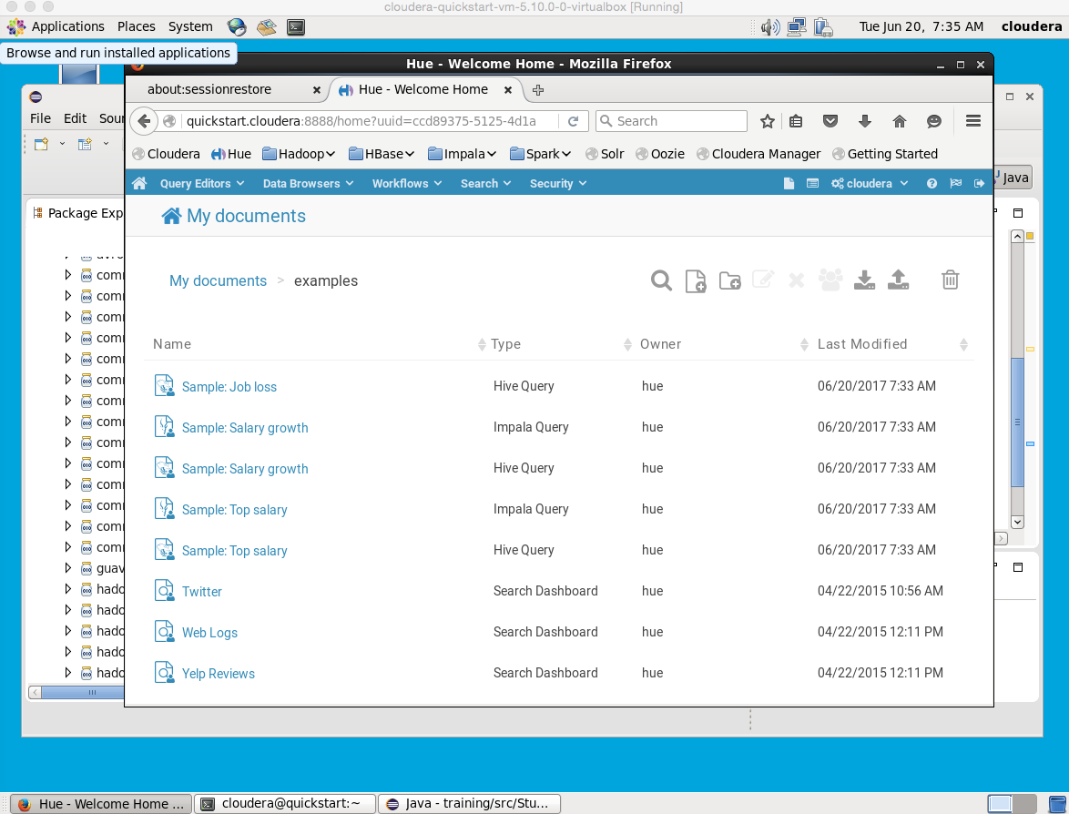
Applications via Hue Browser Login/password: cloudera/cloudera

Slide 16
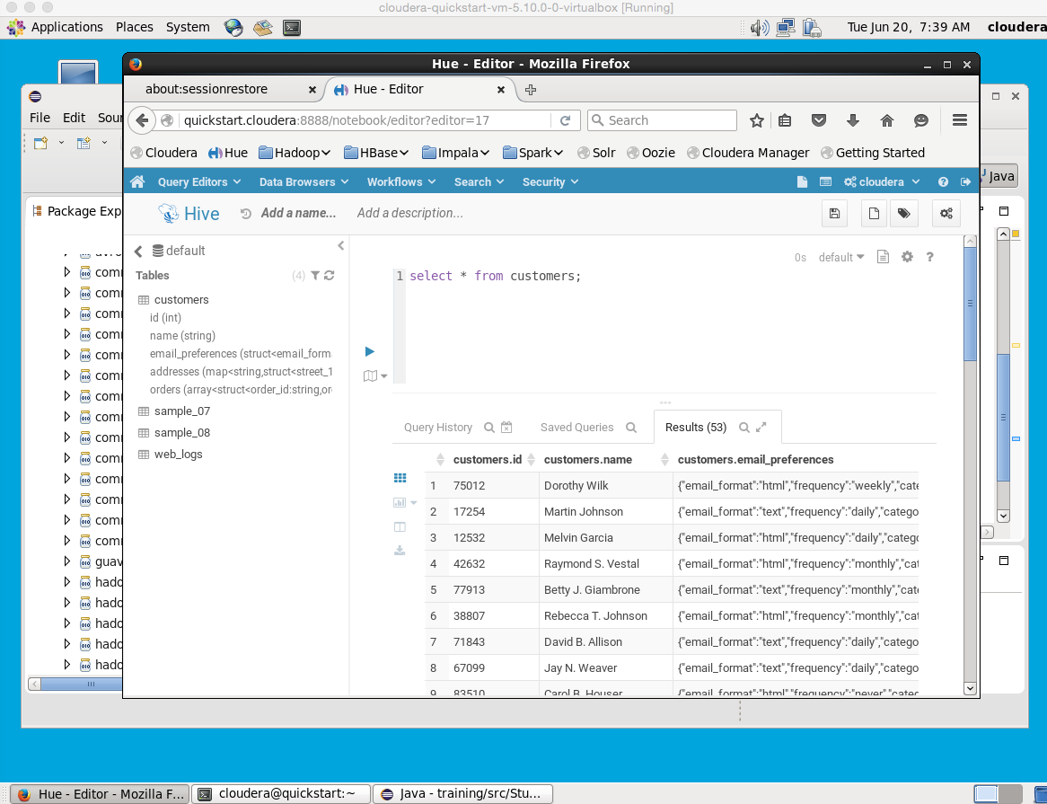
Example: Query Editors - Hive

Slide 17
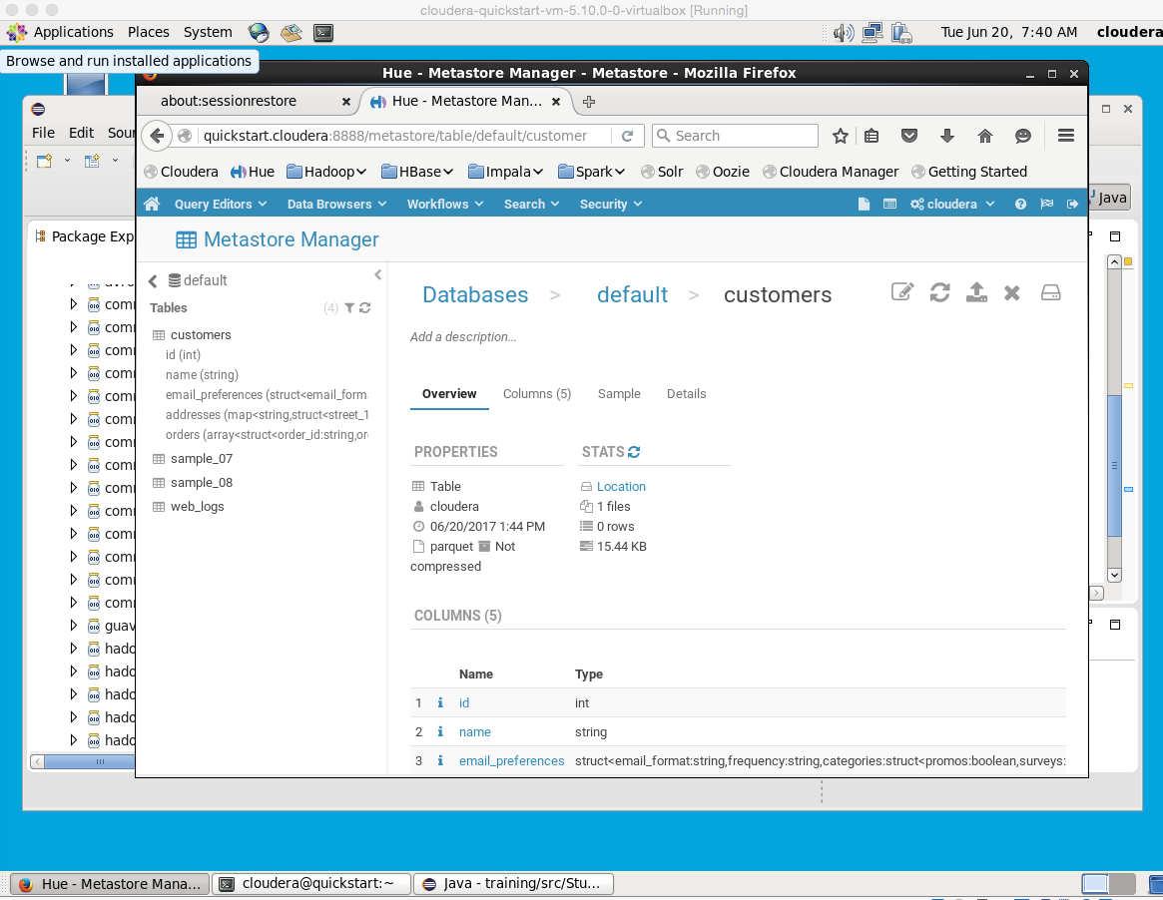
Metastore browser

Slide 18
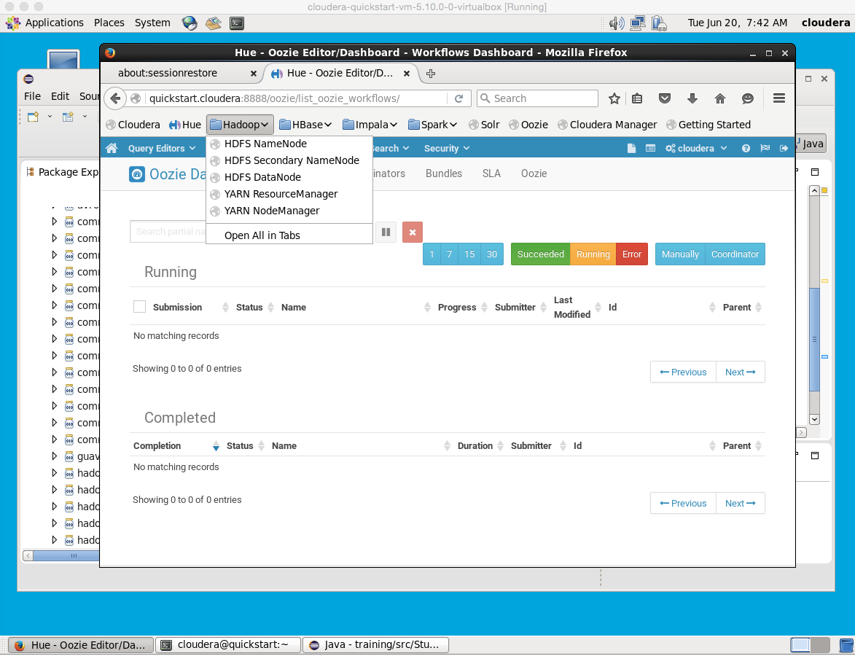
Hadoop Configuration

Slide 19
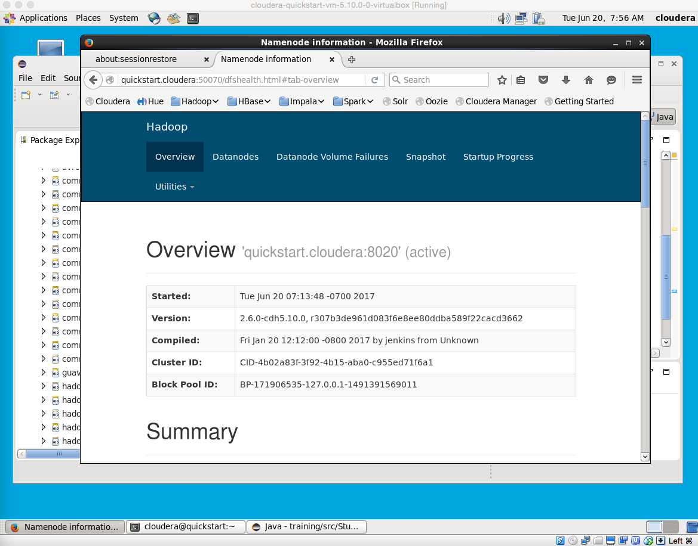
Hadoop Namenode

Slide 20
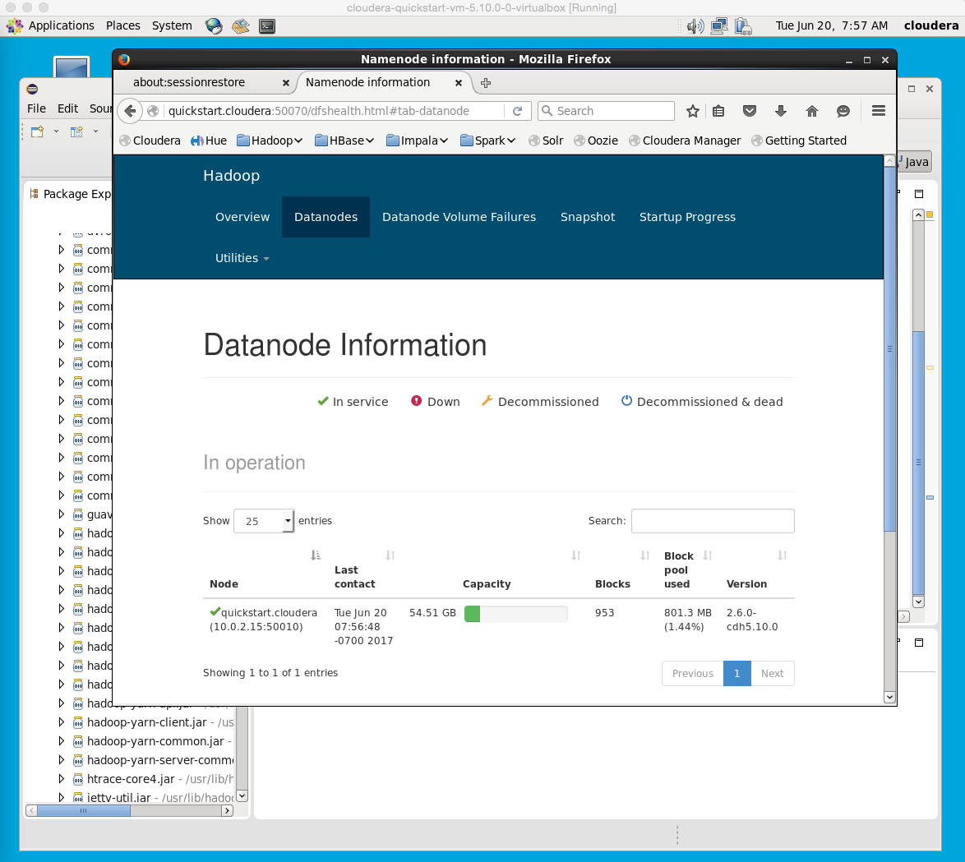
Datanode – single datanode due to pseudo distributed mode

Slide 21
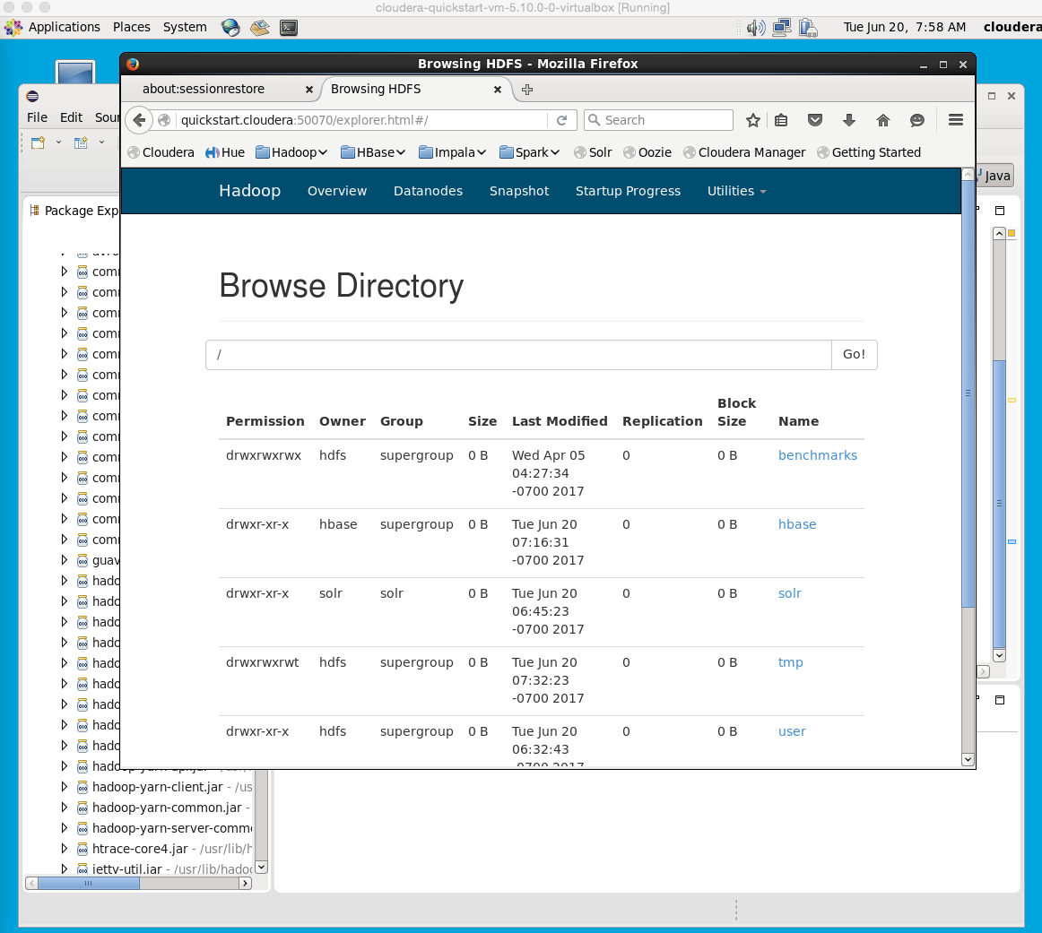
Datanode

Slide 22
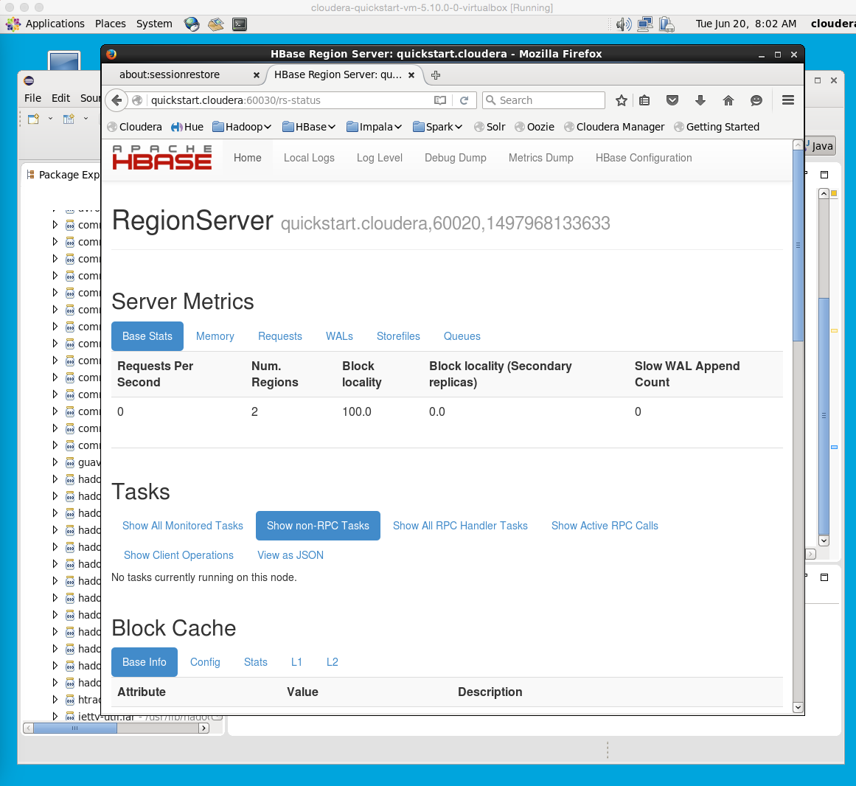
HBase

Slide 23
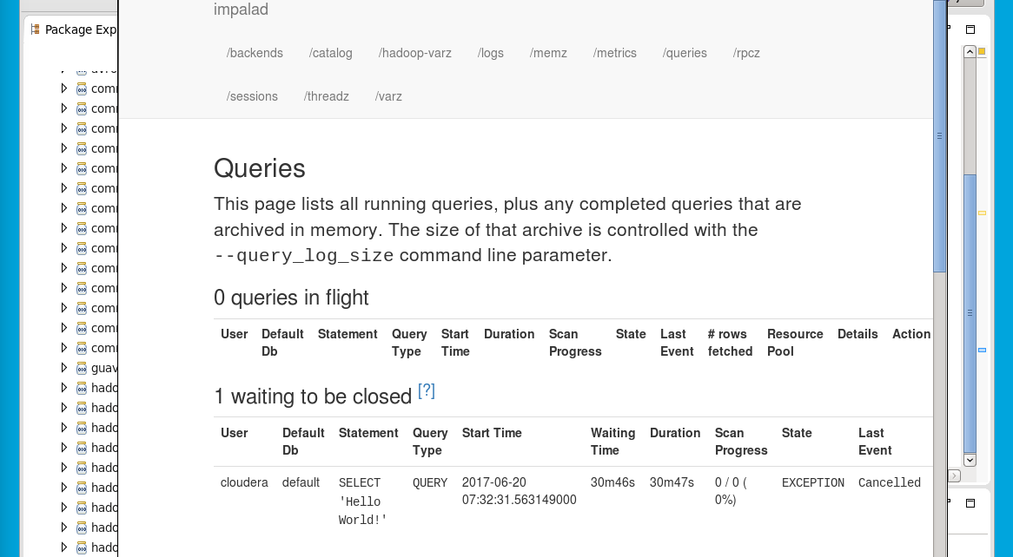
Cloudera Impala – in-memory database

Slide 24
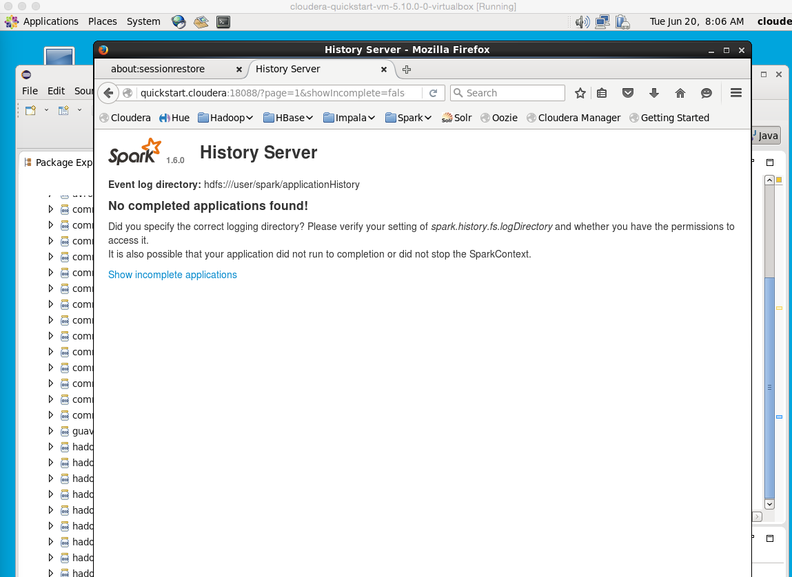
Spark – in-memory processing & analytics

Slide 25
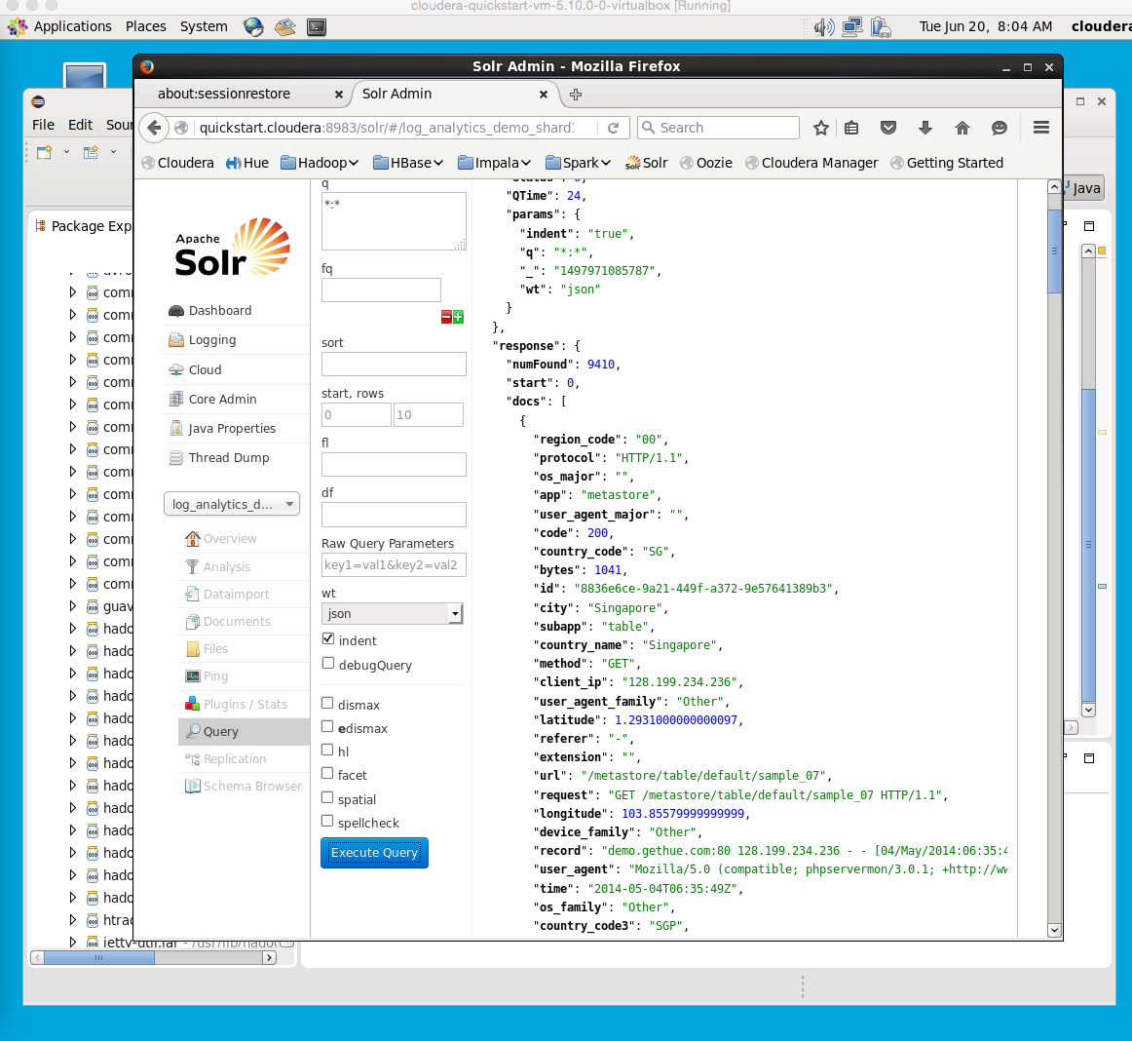
Solr Search

Slide 26
Review
Which of the following Hadoop libraries gives you the ability to have SQL-like, or HQL query and creates batch MapReduce jobs with that query?
Postgress
Mahout
Hive
Pig
Impala
Which IDE for Python
MS Visual Studio
Eclipse
Sublime
Rstudio
PyCharm
Spyder

